Slide 1
Socratic-Virtue Philosophy-Guided Self-Discovery and Emotional Wellness Platform
CSE7101- Capstone Project
Review-1
Batch Number:
Under the Supervision of,
Dr./Mr./Ms./Prof.
Professor / Associate Professor / Assistant Professor
School of Computer Science and Engineering
Presidency University
Roll Number | Student Name
20221CSE0574 | Abdul Rahman
20221CSE0553 | Rahul R Shetty
20221CSE0563 | Varunraj R Naik
Name of the Program: Computer Science & Engineering
Name of the HoD: Dr. Asif Mohammed
Name of the Program Project Coordinator: Dr. Jayavadiel Ravi
Name of the School Project Coordinators: Dr. Sampath A K , Dr. Geetha A

Slide 2
Content
Problem Statement
Objectives
Background and Related work for title Selection
Analysis of Problem Statement
Innovation or Novel Contributions
Git-hub Link
Timeline of the Project
References

Slide 3
Problem Statement Number: PSCS_151
Organization: AICTE, MIC-Student Innovation
Category (Hardware / Software / Both) : Software
Problem Statement:
Teenagers often face emotional challenges from social media pressure, academic stress, and life changes.
Many existing wellness or mood tracking apps feel generic and lack deeper personal connection.
Philosophy offers powerful lessons for self-reflection and balance but is seen as too complex for everyday use.
There is a need for a safe, engaging space that combines simple philosophical insights with practical tools like mood tracking and reflection to build self-awareness and emotional stability.

Slide 4
Innovation / Novel Contributions
First platform to merge philosophy-driven learning with mood analytics – Blends philosophical wisdom with mood tracking to make self-discovery practical and engaging.
Emotion-based content recommendations – Delivers personalized insights and prompts based on a user’s mood trends.
Engaging, teen-friendly design without losing depth for older users – Simple, relatable UI for teens with deeper layers for mature users.
Roadmap from web app (MERN stack) to mobile app (React Native) – Launch as a web app, later expand to a mobile app with advanced features.

Slide 5
Objectives :
Deliver relatable, bite-sized philosophical insights.
Enable quick, intuitive mood tracking with analytics.
Provide reflective prompts tied to emotions.
Ensure user privacy and safe self-expression.
Encourage emotional stability and personal growth.

Slide 6
Background & Related Work
Existing Tools: Daylio, Moodfit, Calm, School of Life content.
Gaps Identified:
Mood trackers often lack deep reflective learning.
Philosophy resources are rarely interactive or youth-friendly.
Opportunity: Combine philosophical wisdom + mood tracking to create a daily self-discovery habit.

Slide 7
Analysis of Problem Statement (contd...)
Target Audience: All ages, with special focus on teenagers (WHO: 1 in 7 teens face mental health challenges).
Key Issues: Low self-awareness, emotional instability, limited relatable self-help tools.
Gap: Few apps integrate philosophical guidance with emotional tracking.
Solution: Blend accessible philosophical content with mood logging, reflection prompts, and emotional trend analysis.
Impact: Promote self-awareness, balanced emotions, and mindful decision-making.

Slide 8
Analysis of Problem Statement
Technology Stack Components :
Frontend: React.js
Backend: Node.js + Express.js
Database: MongoDB
Other Tools:
Version Control: GitHub (public repository for project)
UI Library: Material UI / Tailwind CSS (for sleek, responsive design)
Analytics: Chart.js / Recharts (for mood trend visualization)

Slide 9
Github Link
The Github link provided should have public access permission.
Github Link
https://github.com/AbdulRahman8641/Socratic-Virtue.git

Slide 10
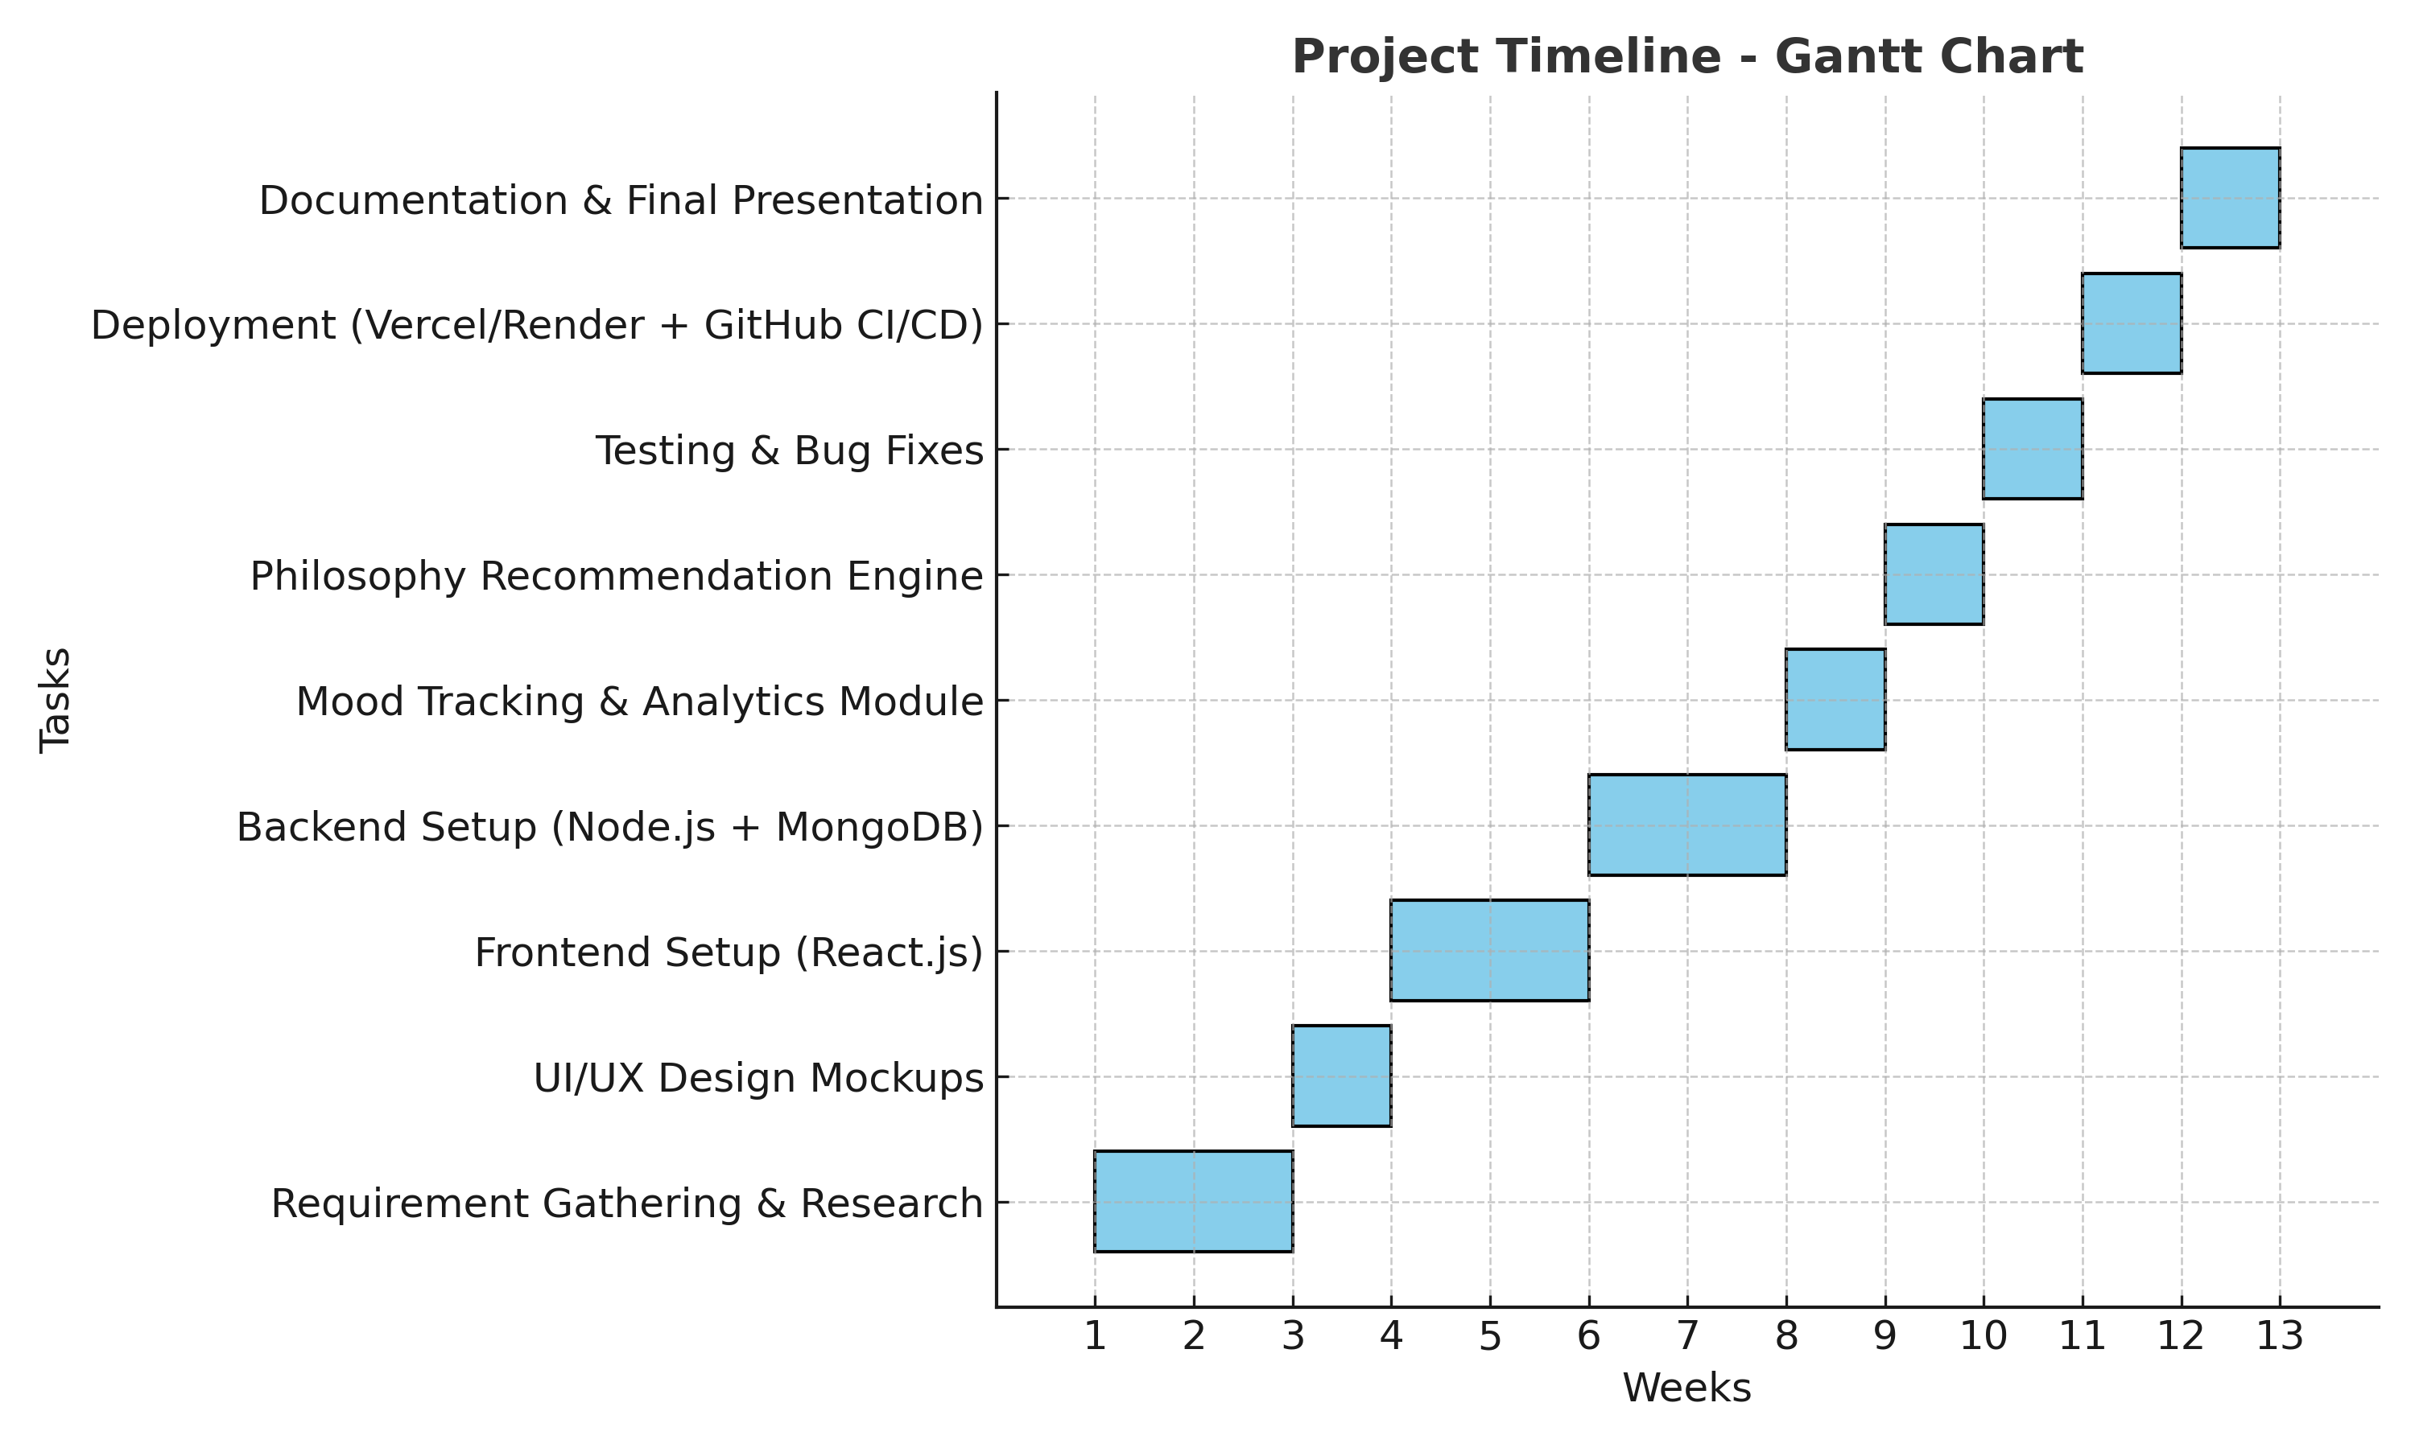
Timeline of the Project (Gantt Chart)

Slide 11
References (IEEE Paper format)
[1]. A. Kumar, B. R. Patel, and C. Zhang, “Plant disease identification using convolutional neural networks,” IEEE Access, vol. 9, pp. 34567–34578, Mar. 2021.
[2]. J. Smith, “Deep learning in agricultural systems,” IEEE Transactions on Neural Networks and Learning Systems, vol. 32, no. 7, pp. 1234–1245, Jul. 2021.

Slide 12


